Slide 2
Widget Gallery
Your Score
Company Overview
Level Trending
Drilldown Ranking
Recent [Client label for jobs]
Improvable Questions
Survey Summary
Section Trending
Sections by Level
Announcement
Glossary
Wave Comparison
Key Question
Question Trending
Level Trending - Year Over Year
Net Promoter Score
Notes:
View overall data and click through to see various reporting levels right in the same widget (without ever having to leave the page)

Slide 3
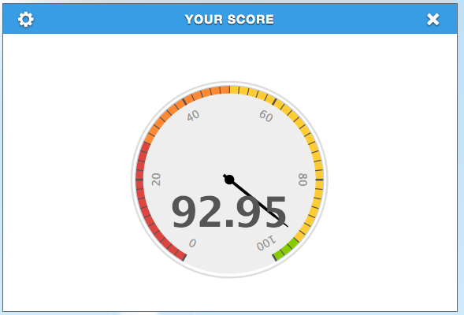
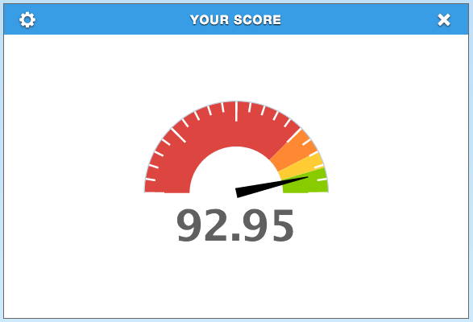
Your Score
Settings: Widget Title, Date Ranges, Surveys, Section, Heat Map, Graph Types, Wave Filter

Slide 4
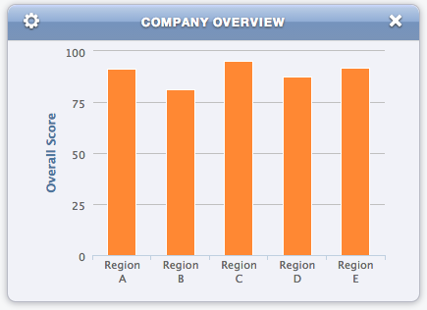
Company Overview
Settings: Widget Title, Date Ranges, Surveys, Graph Type, Widget Sizes, Wave Filter
*Shows peer data
Notes:
View overall data and click through to see various reporting levels right in the same widget (without ever having to leave the page)

Slide 5
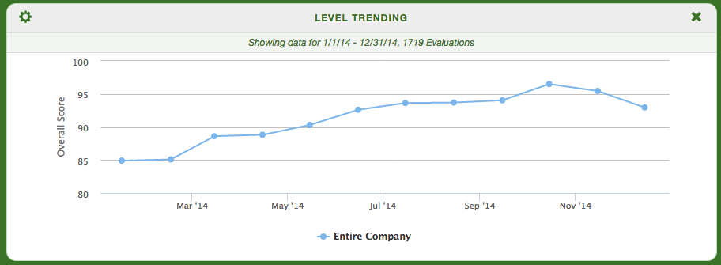
Level Trending
Settings: Widget Title, Date Ranges, Surveys, Graph Type, Widget Sizes, Wave Filter, Custom Date Range Types*
*Shows peer data

Slide 6
Drilldown Ranking
Settings: Widget Title, Date Ranges, Surveys, Show Levels, Heat Map, Wave Filter
*Shows peer data

Slide 7
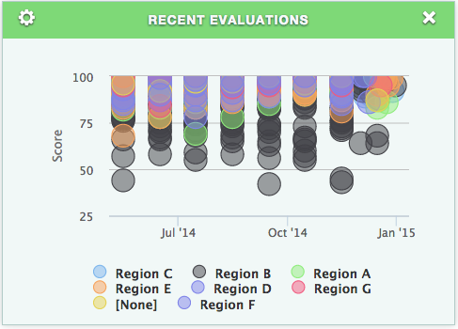
Recent Evaluations
Settings: Widget Title, Date Ranges, Surveys, Widget Sizes, Wave Filter

Slide 8
Improvable Questions
Settings: Widget Title, Date Ranges, Surveys, Question Sets, Wave Filter, Number of Questions

Slide 9
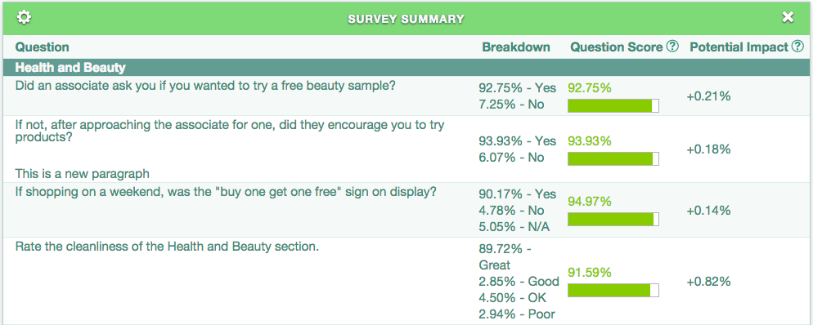
Survey Summary
Settings: Widget Title, Date Ranges, Surveys, Sections, Heat Maps, Question Sets, Columns, Widget Sizes, Wave Filter

Slide 10
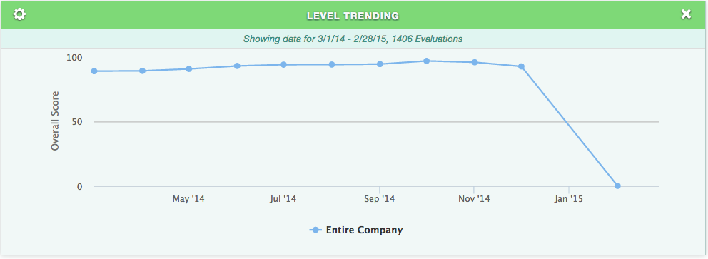
Sections by Level
Settings: Widget Title, Date Ranges, Surveys, Line Types, Sections, Custom Date Range Types, Wave Filter

Slide 11
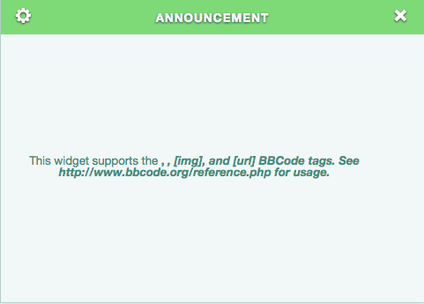
Announcement
Settings: Widget Title, Widget Text, Widget Sizes

Slide 12
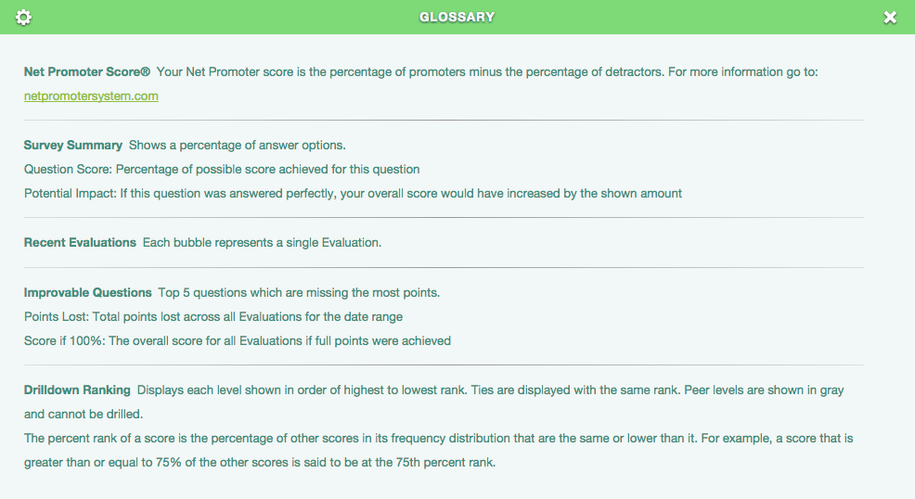
Glossary
Settings: Widget Title

Slide 13
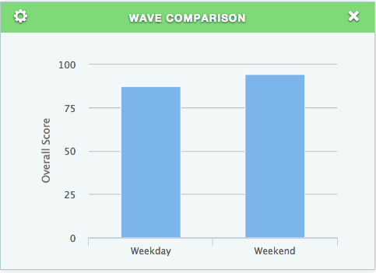
Wave Comparison
Settings: Widget Title, Date Ranges, Surveys, Graph Types, Widget Sizes, Wave Filter

Slide 14
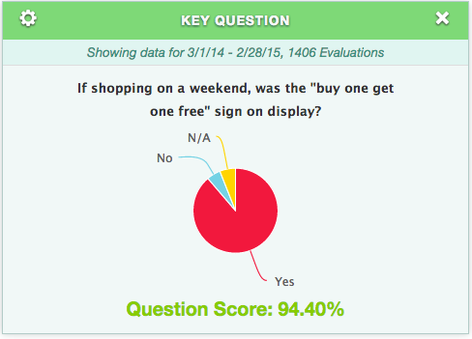
Key Question
Settings: Widget Title, Date Ranges, Surveys, Questions, Heat Map, Wave Filter, Question Text

Slide 15
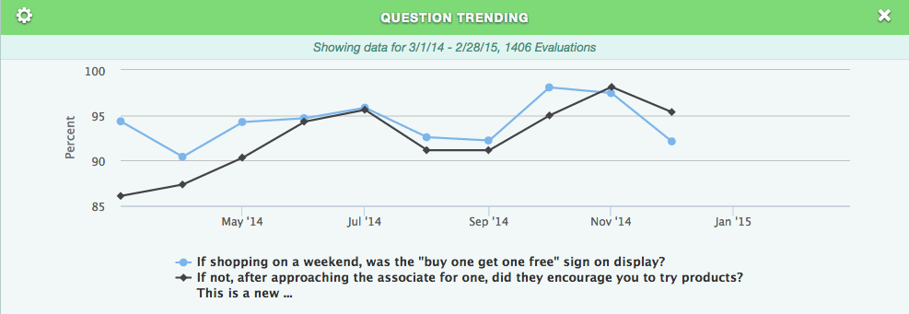
Question Trending
Settings: Widget Title, Date Ranges, Surveys, Questions, Question Set, Custom Date Ranges, Wave Filter

Slide 16
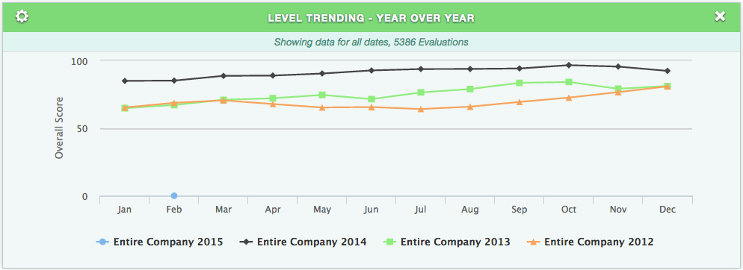
Level Trending- Year Over Year
Settings: Widget Title, Date Ranges, Surveys, Line Types, Wave Filter

Slide 17
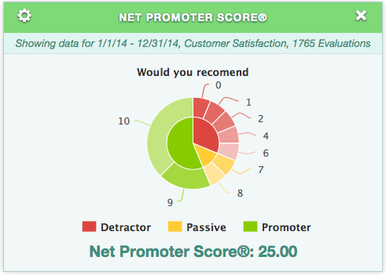
Net Promoter Score
Settings: Widget Title, Date Ranges, Surveys, NPS Question, Question Text, Wave Filter, Pie Types

Slide 18
Settings Gallery
Widget Title
Date Ranges
Survey
Sections
Heat Map
Wave Filter
Graph Types One
Graph Types Two
Widget Size
Custom Date Ranges
Show Levels
Questions
Question Sets
Number of Questions
Columns
Line Types
Widget Text
Question Text
NPS Question

Slide 19
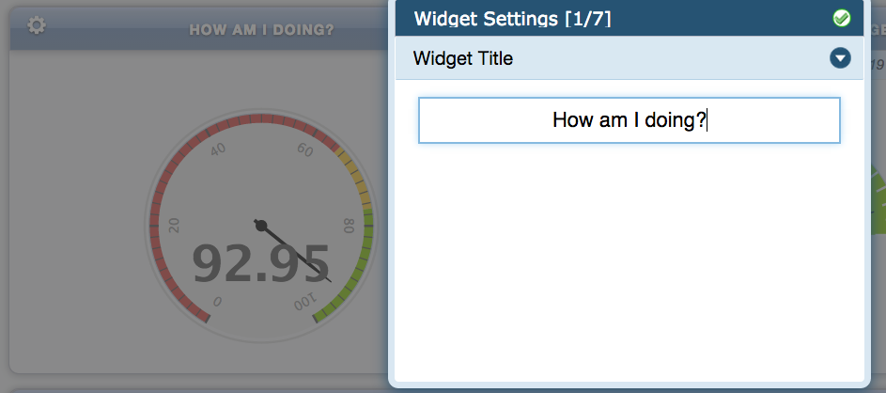
Settings: Rename your widget
-Deleting the name of a renamed widget sets it back to the default
* All Widgets

Slide 20
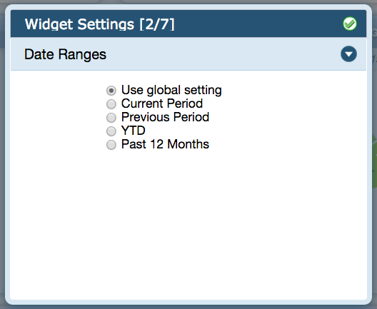
Settings: Date Ranges
Use Global Setting
Defaults to the last month or date range with data, if adjusted in the controls, changes all widgets set to Use Global Setting
Current Period
All shops in the current month or date range with data
Previous Period
All shops in the previous month or data range with data
YTD
Shows data since the beginning of the year
Past 12 months
Shows data 12 months back
* All Widgets

Slide 21
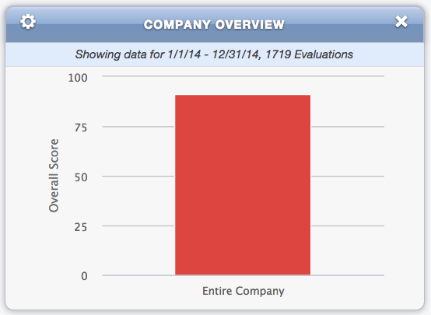
Settings: Date Ranges
Override Global Settings
Any widget showing data for a date range that is not the date range in Global Settings will indicate this within the widget
* All Widgets

Slide 22
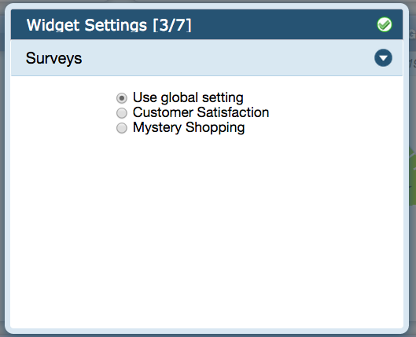
Settings: Surveys
Use Global Setting
Use the default for the entire view
If adjusted in the controls, all widgets set to Use Global Setting will show data for the new survey
Defaults to the newest Survey created
The default can be adjusted by creating a new view and selecting a different Global survey for the view
Additional Surveys listed
Will vary by actual surveys for the client
Can be used to display data for any active survey within a client
* All Widgets

Slide 23
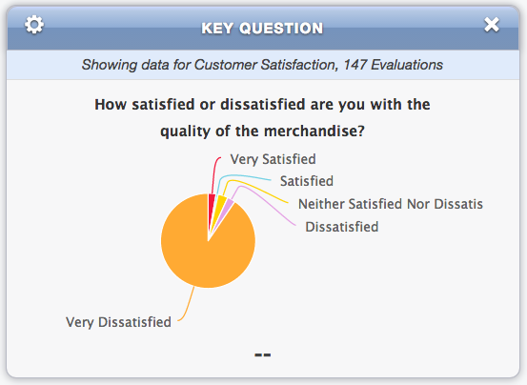
Settings: Surveys
Override Global Setting
Any widget showing data for a survey that is not the survey in Global Settings will indicate this within the widget
* All Widgets

Slide 24
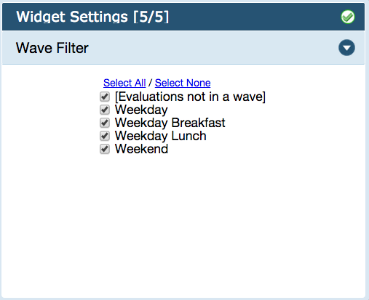
Settings: Wave Filter
Filters widget results for selected wave(s)
* All Widgets

Slide 25
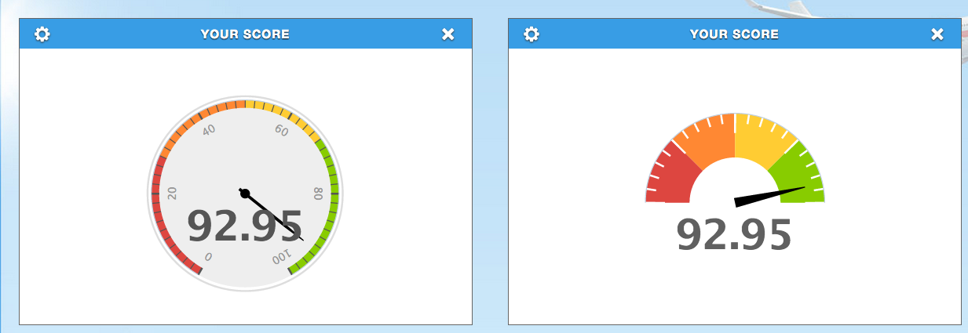
Settings: Graph Types One
Speedometer
* Your Score

Slide 26
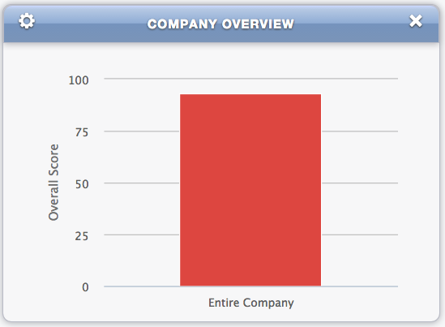
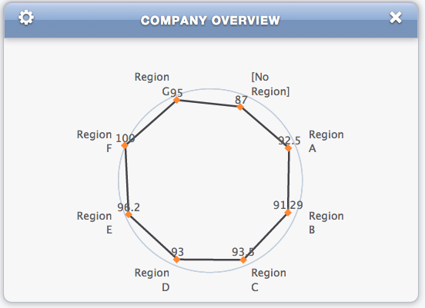
Settings: Graph Types Two
Bar Graph
Flat – Drilldown Bar Graph
Spider, Drilldown spider graph
* Company Overview, Wave Comparison

Slide 27
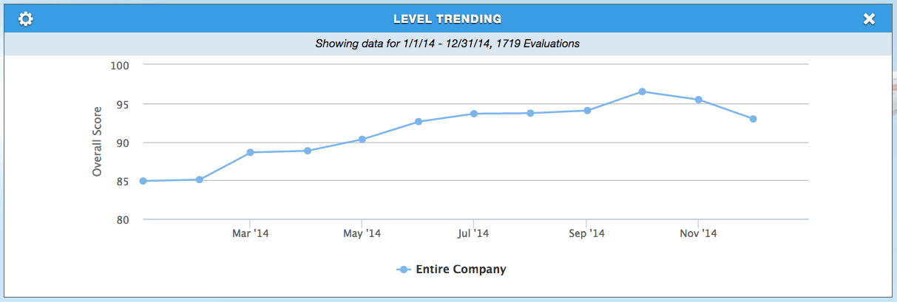
Settings: Line Types
Normal
Filled
* Level Trending, Section Trending, Section by Level, Question Trending, Level Trending Year over Year

Slide 28
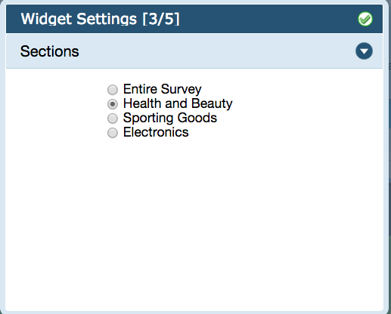
Settings: Sections
Filters widget results by section
* Your Score, Level Trending, Level Trending Year over Year

Slide 29
Settings: Sections
See all section, major sections or minor sections
* Section Trending, Section by level

Slide 30
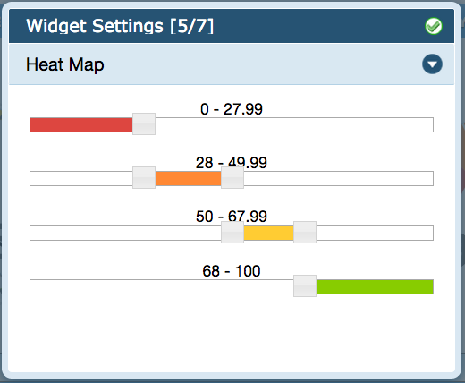
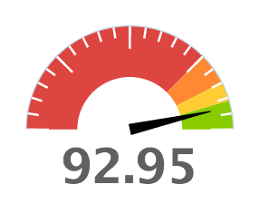
Settings: Heat Map
Adjust the color of scores and graphs
* Section Trending, Section by level, Survey Summary, Your Score

Slide 31
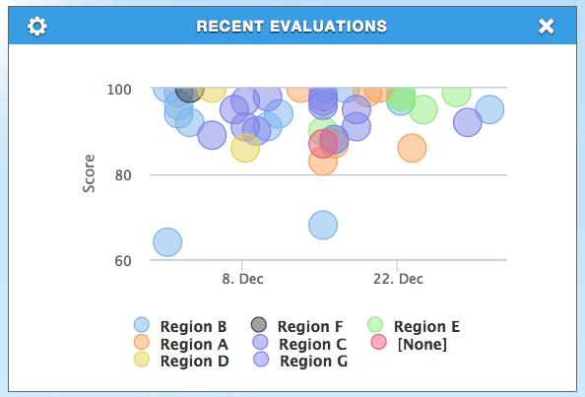
Settings: Widget Size
Have widget take up half the page or the full page
* Company Overview, Recent Shops, Wave Comparison

Slide 32
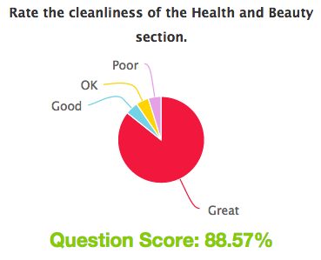
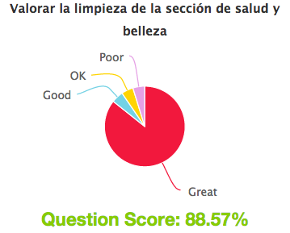
Settings: Question Sets
Display default set or the User’s preference
* Improvable Questions, Survey Summary, Key Questions, Question Trending

Slide 33
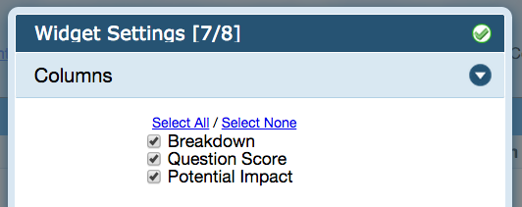
Settings: Columns
Hide columns on the Survey Summary
* Survey Summary

Slide 34
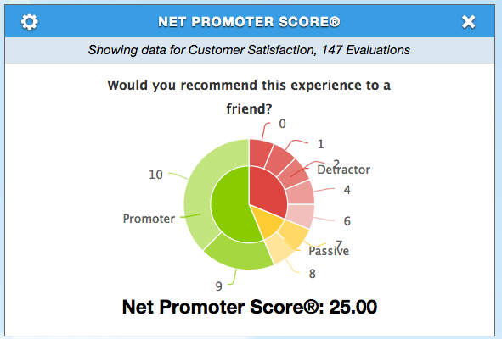
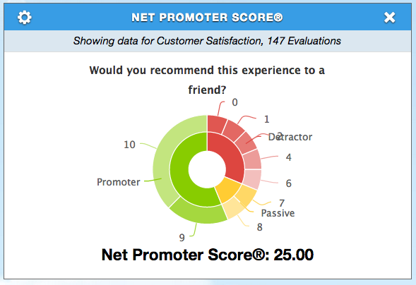
Settings: Pie Types
* NPS Score
Pie
Donut

